Slide 1
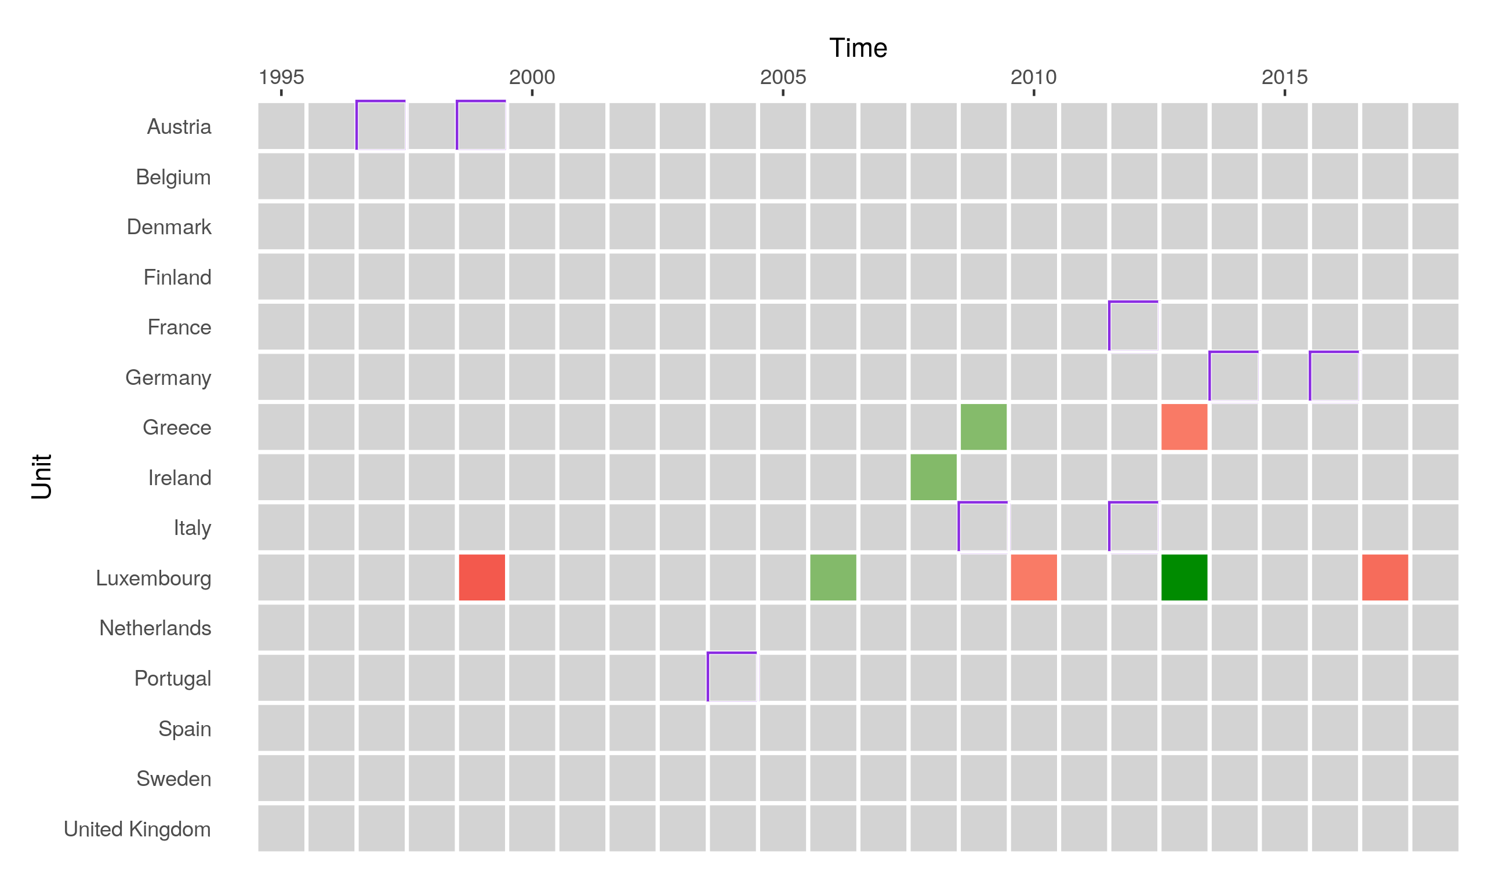
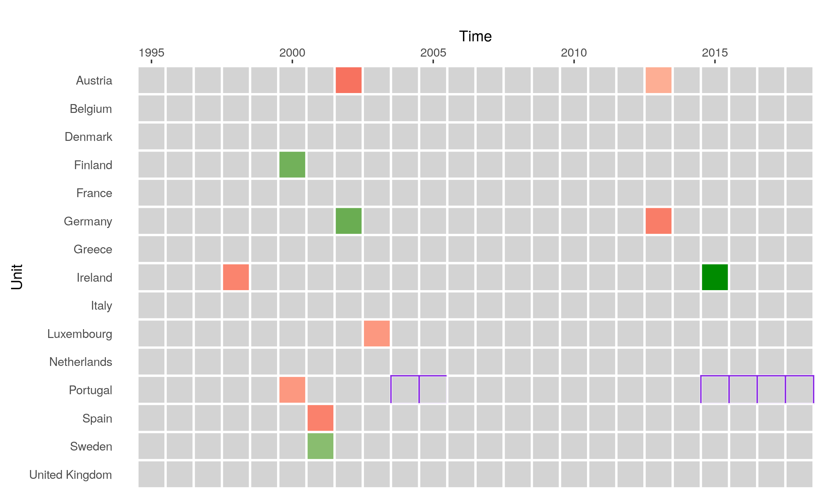
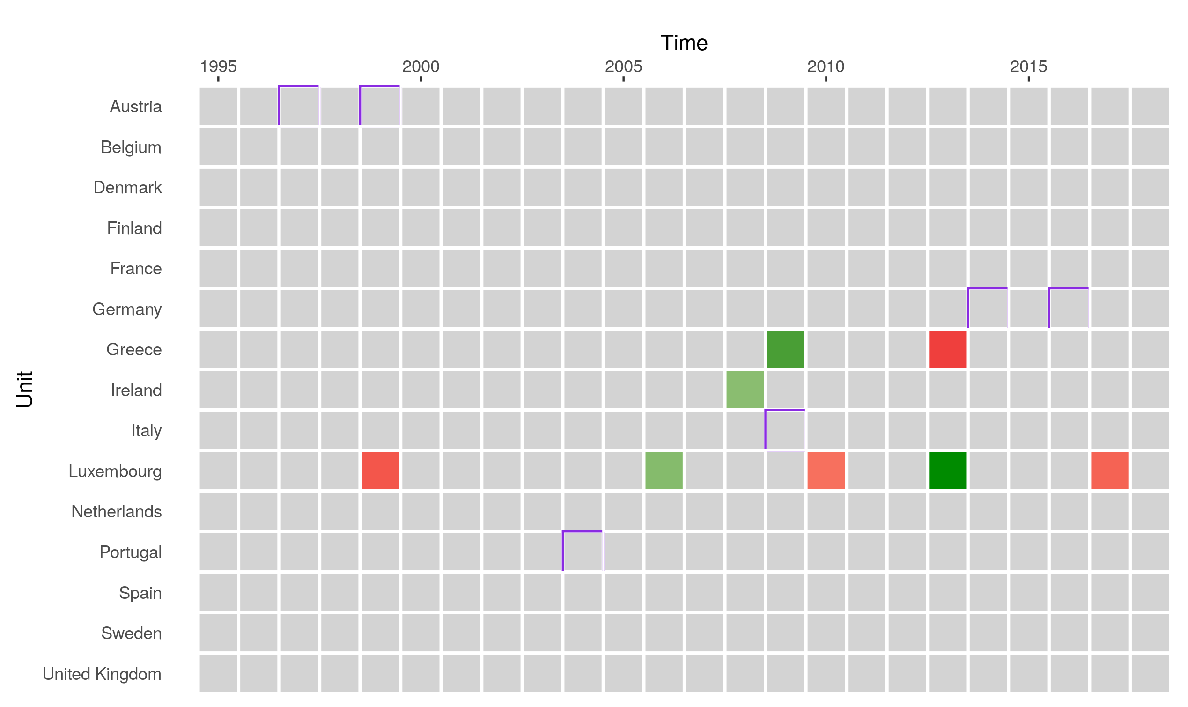
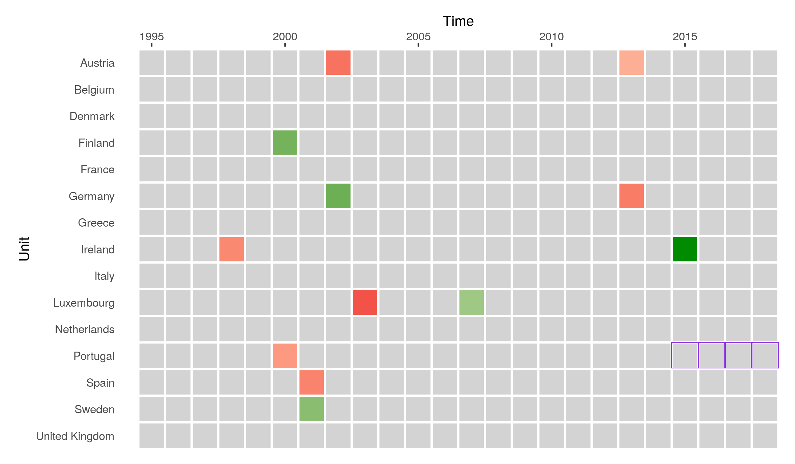
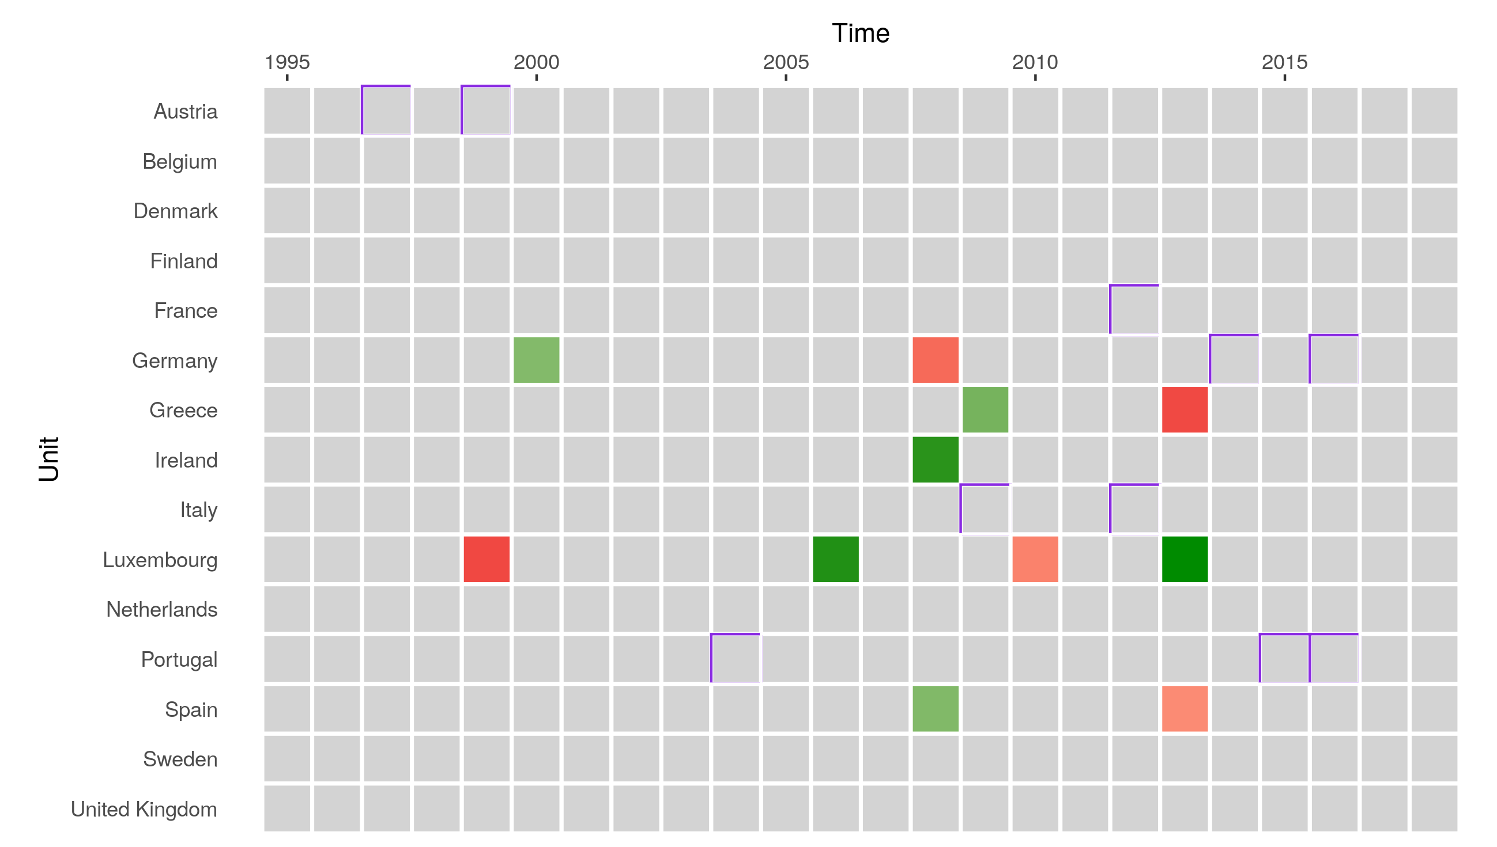
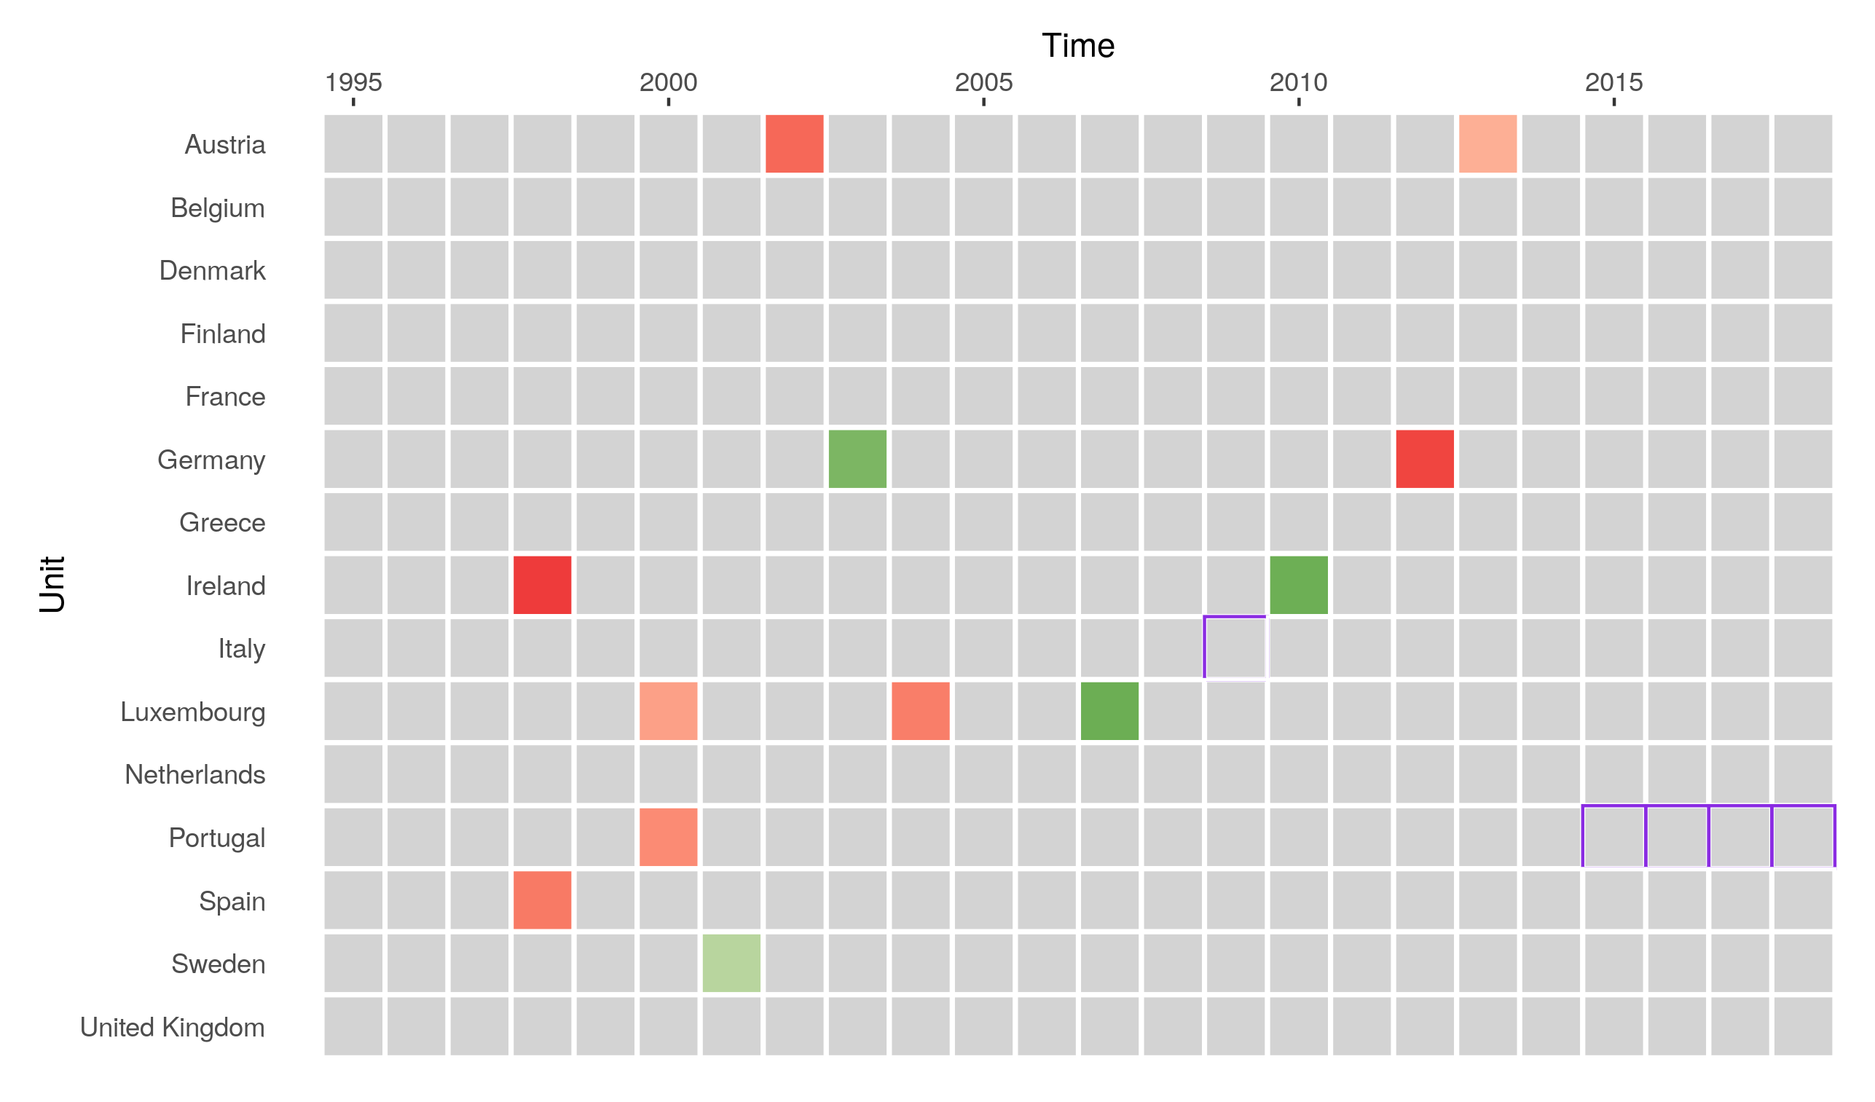
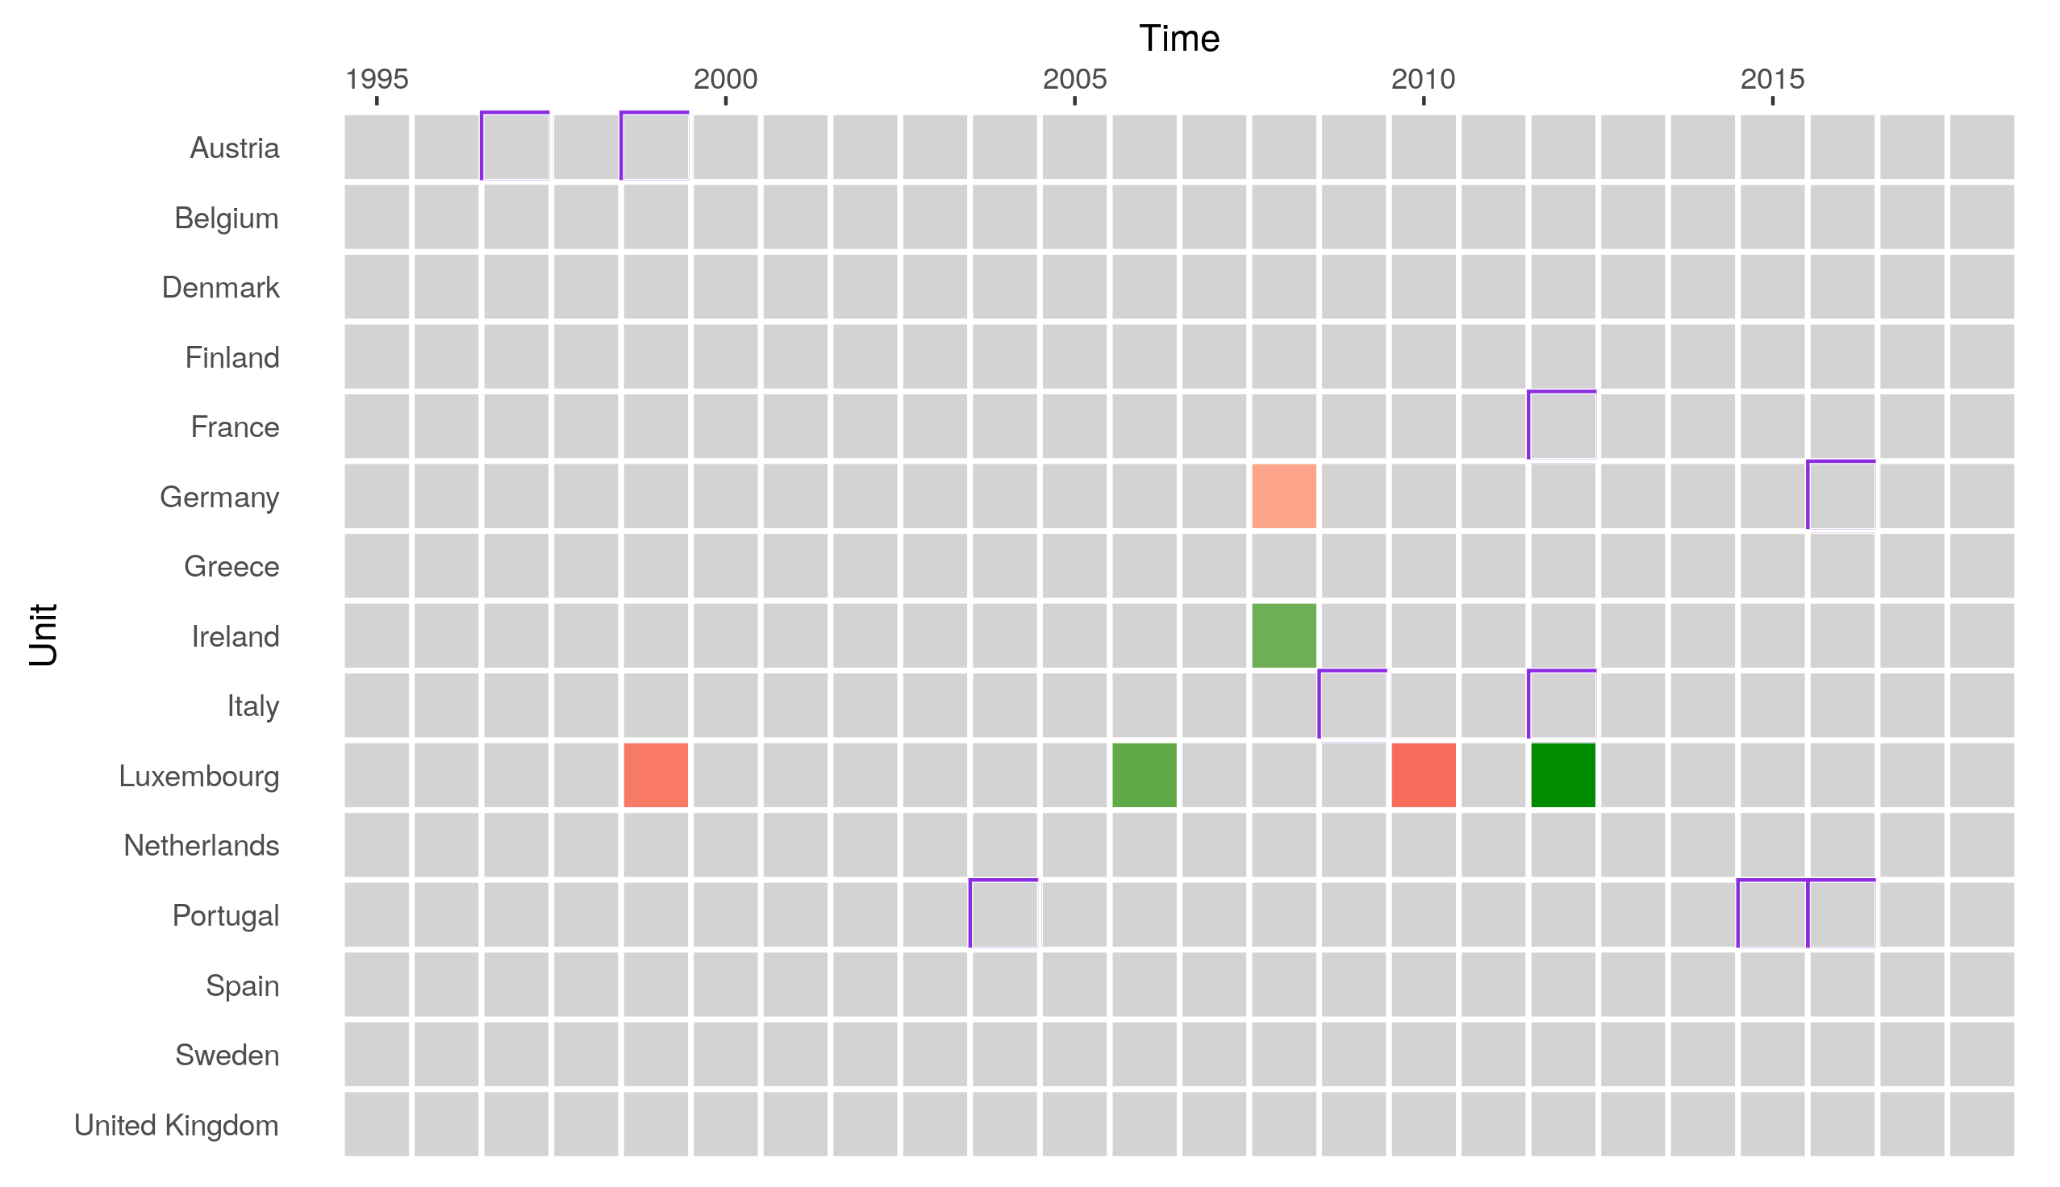
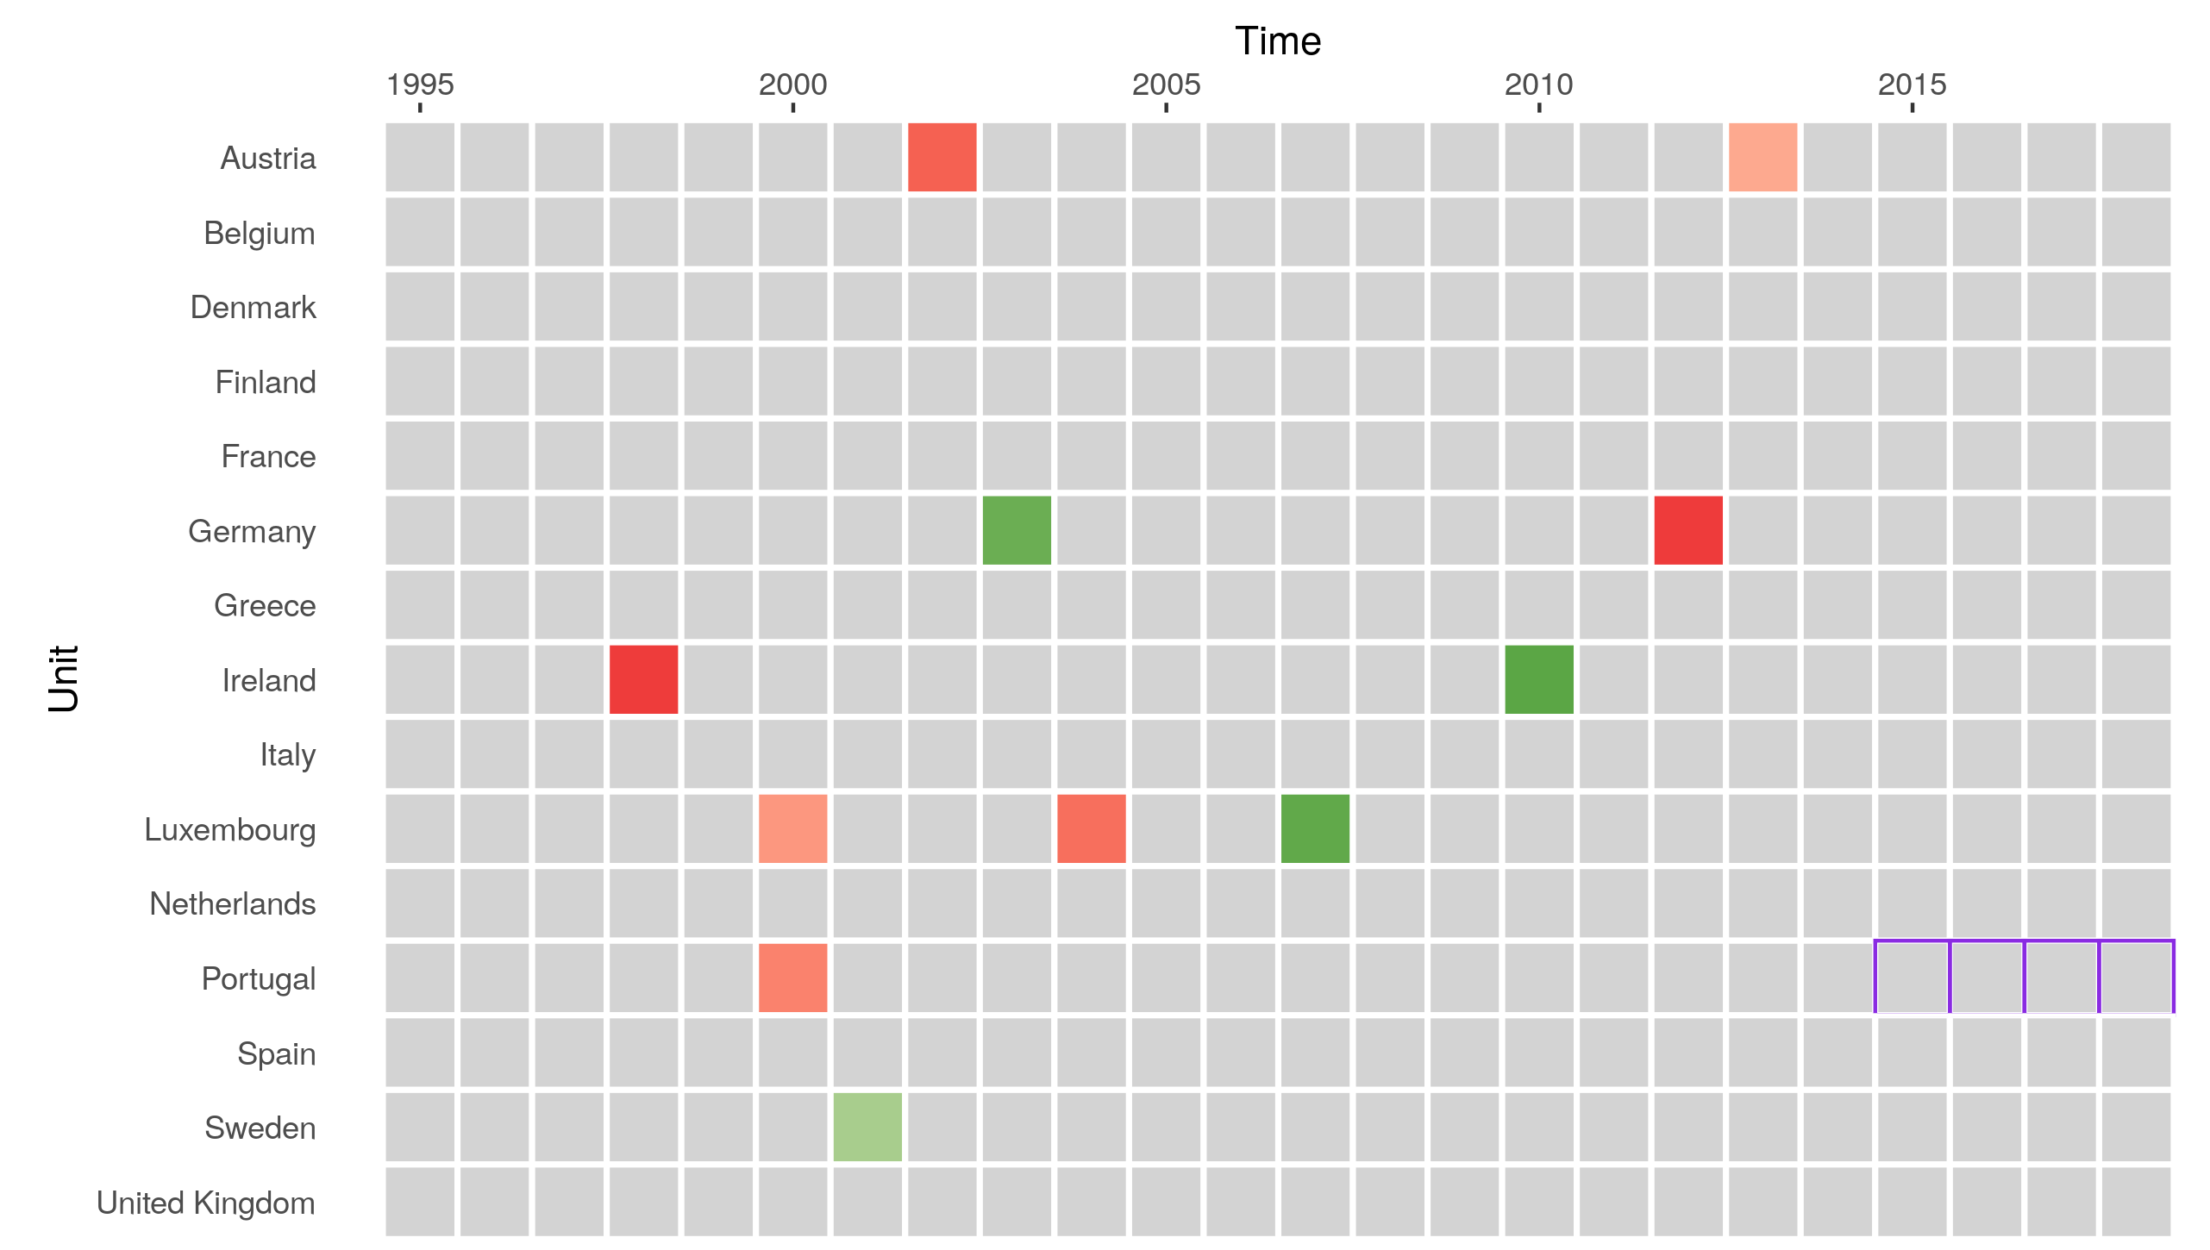
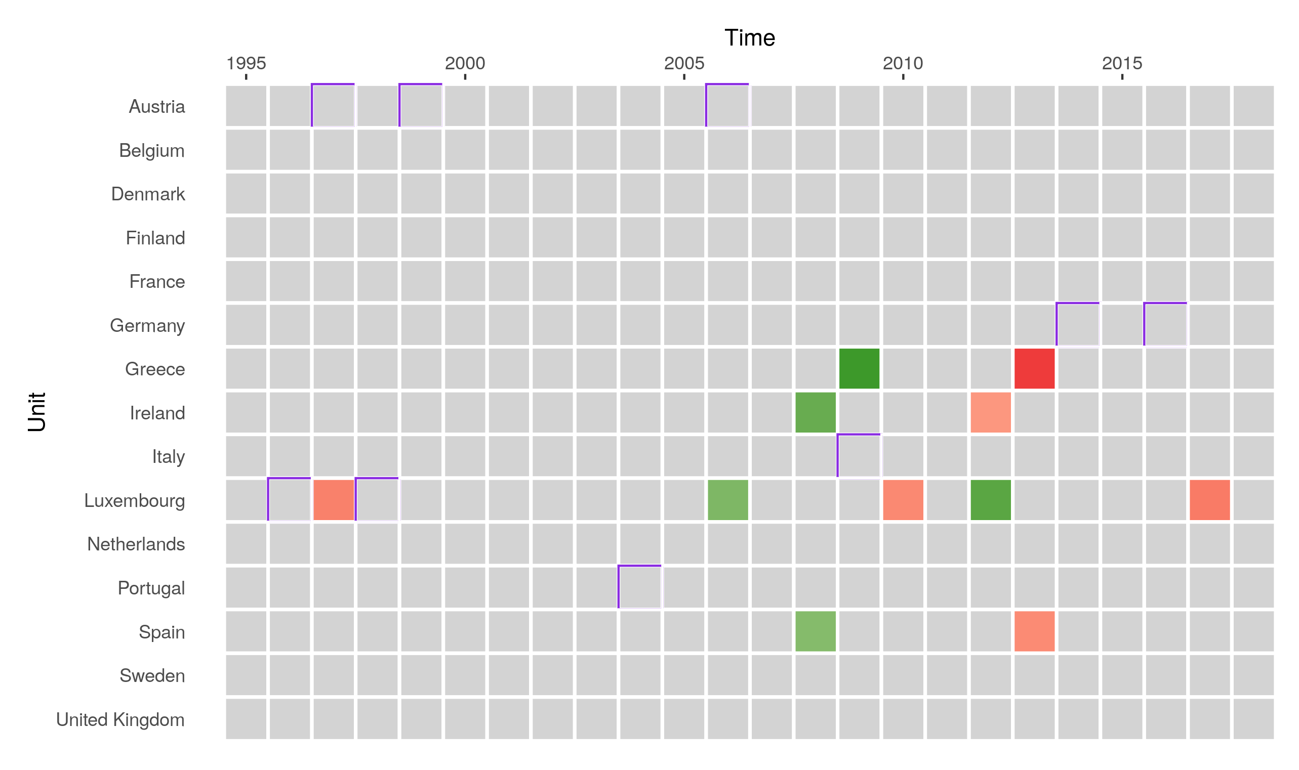
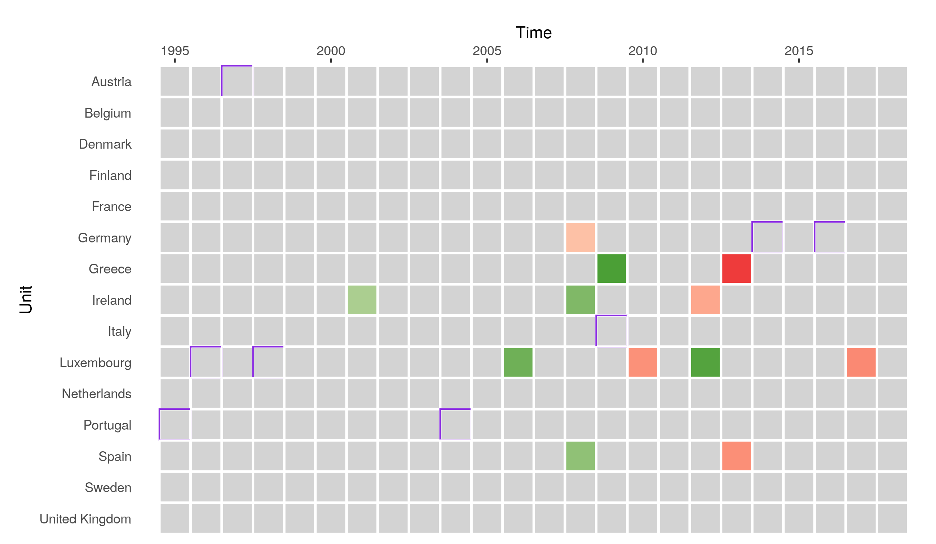
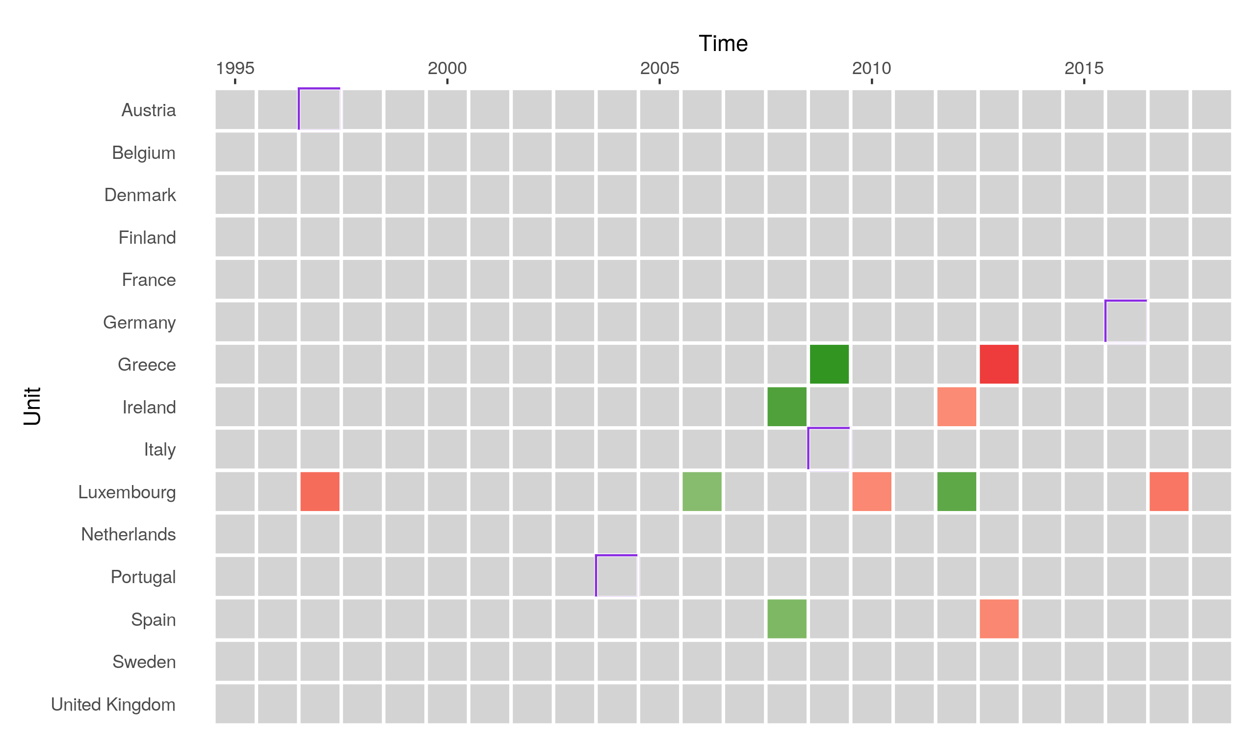
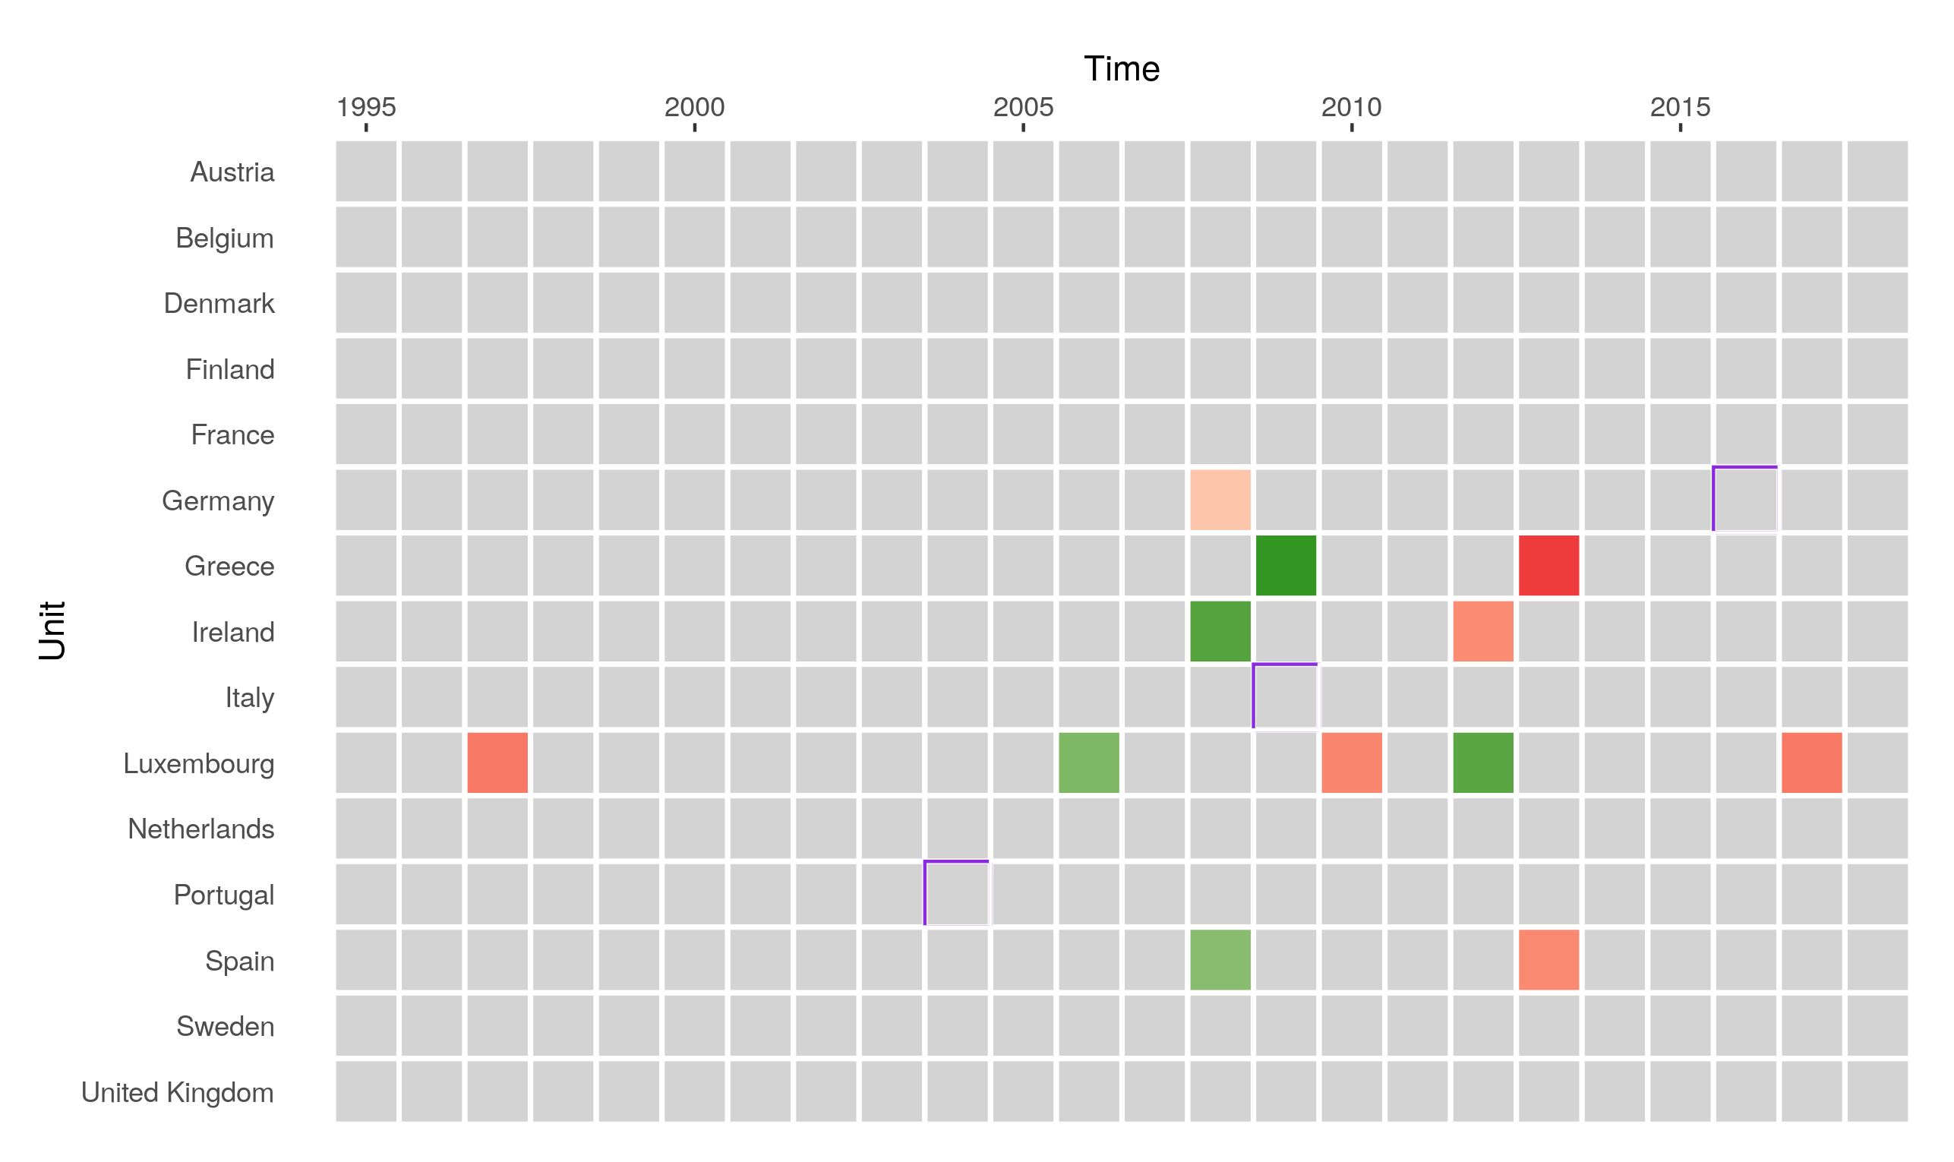
EU15
DV: log(CO2)
with autoregressive lag
without autoregressive lag
1%
False Positive Rate: 0.5%
DV: log(CO2 p.c.)
with autoregressive lag
without autoregressive lag
1%
False Positive Rate: 0.5%
DV: growth rate(CO2 p.c.)
with autoregressive lag
without autoregressive lag
1%
False Positive Rate: 0.5%

Slide 2
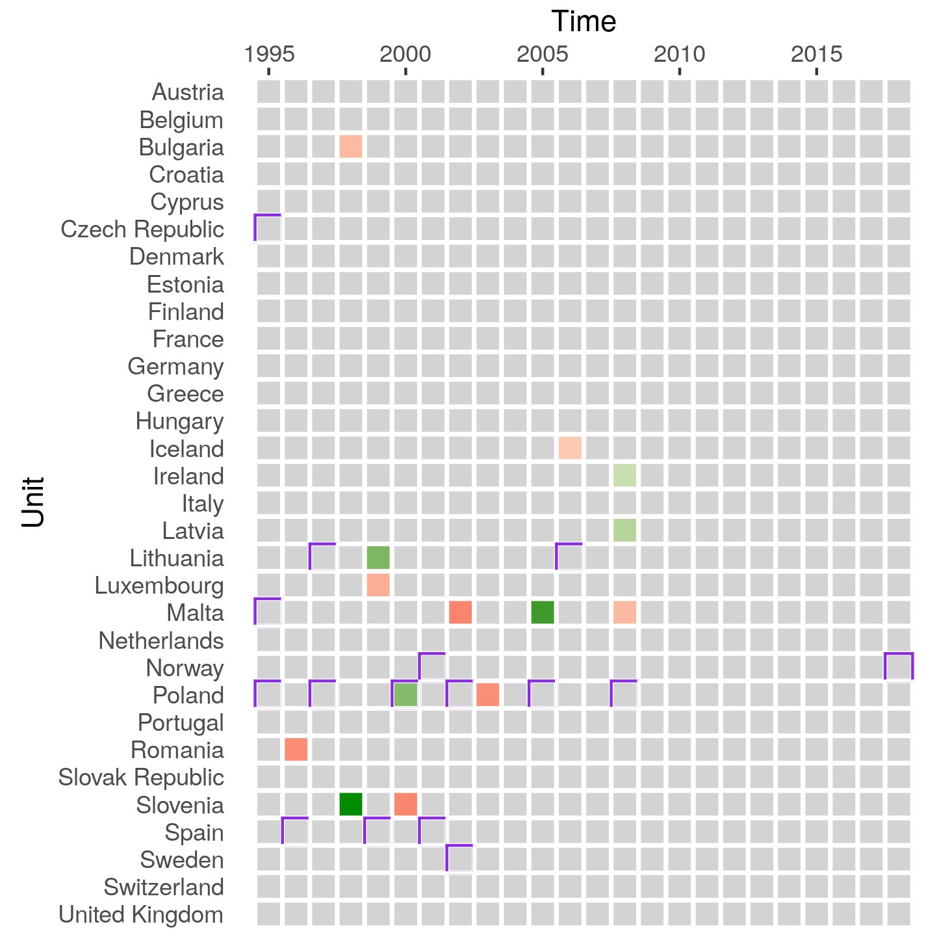
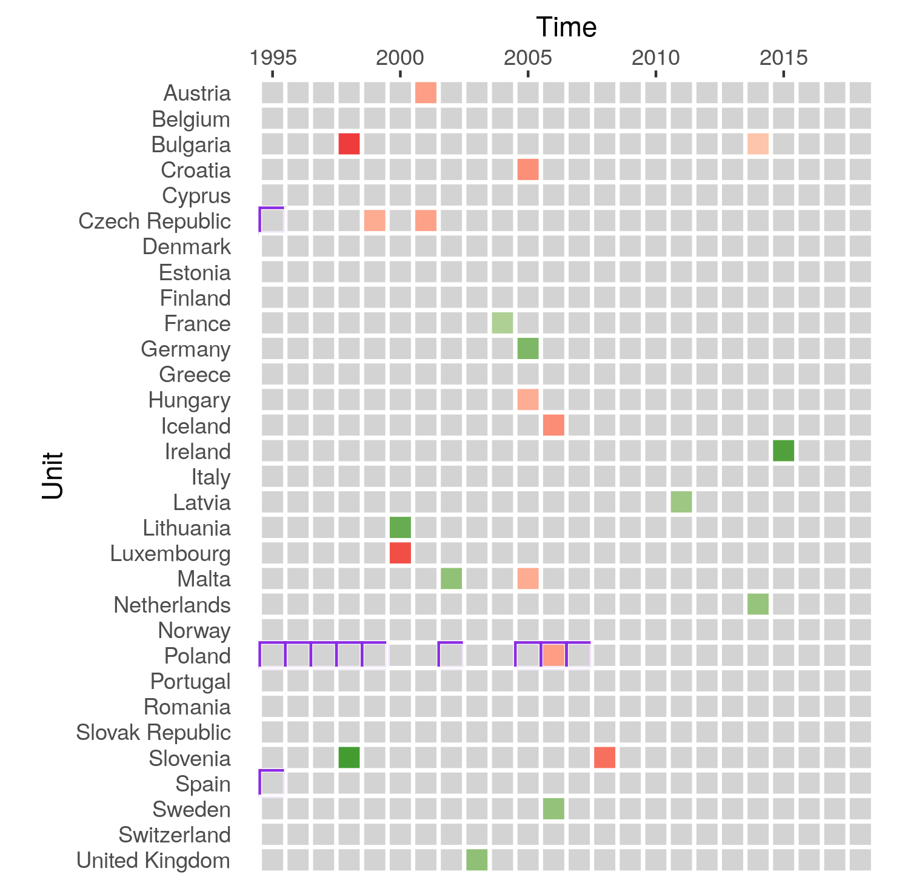
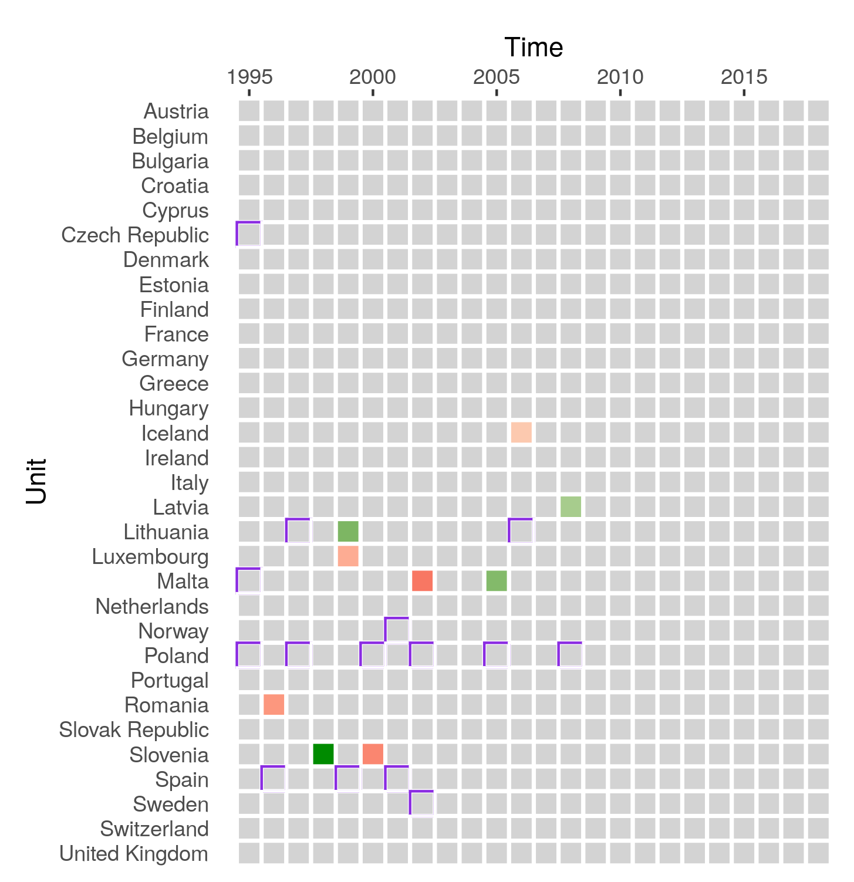

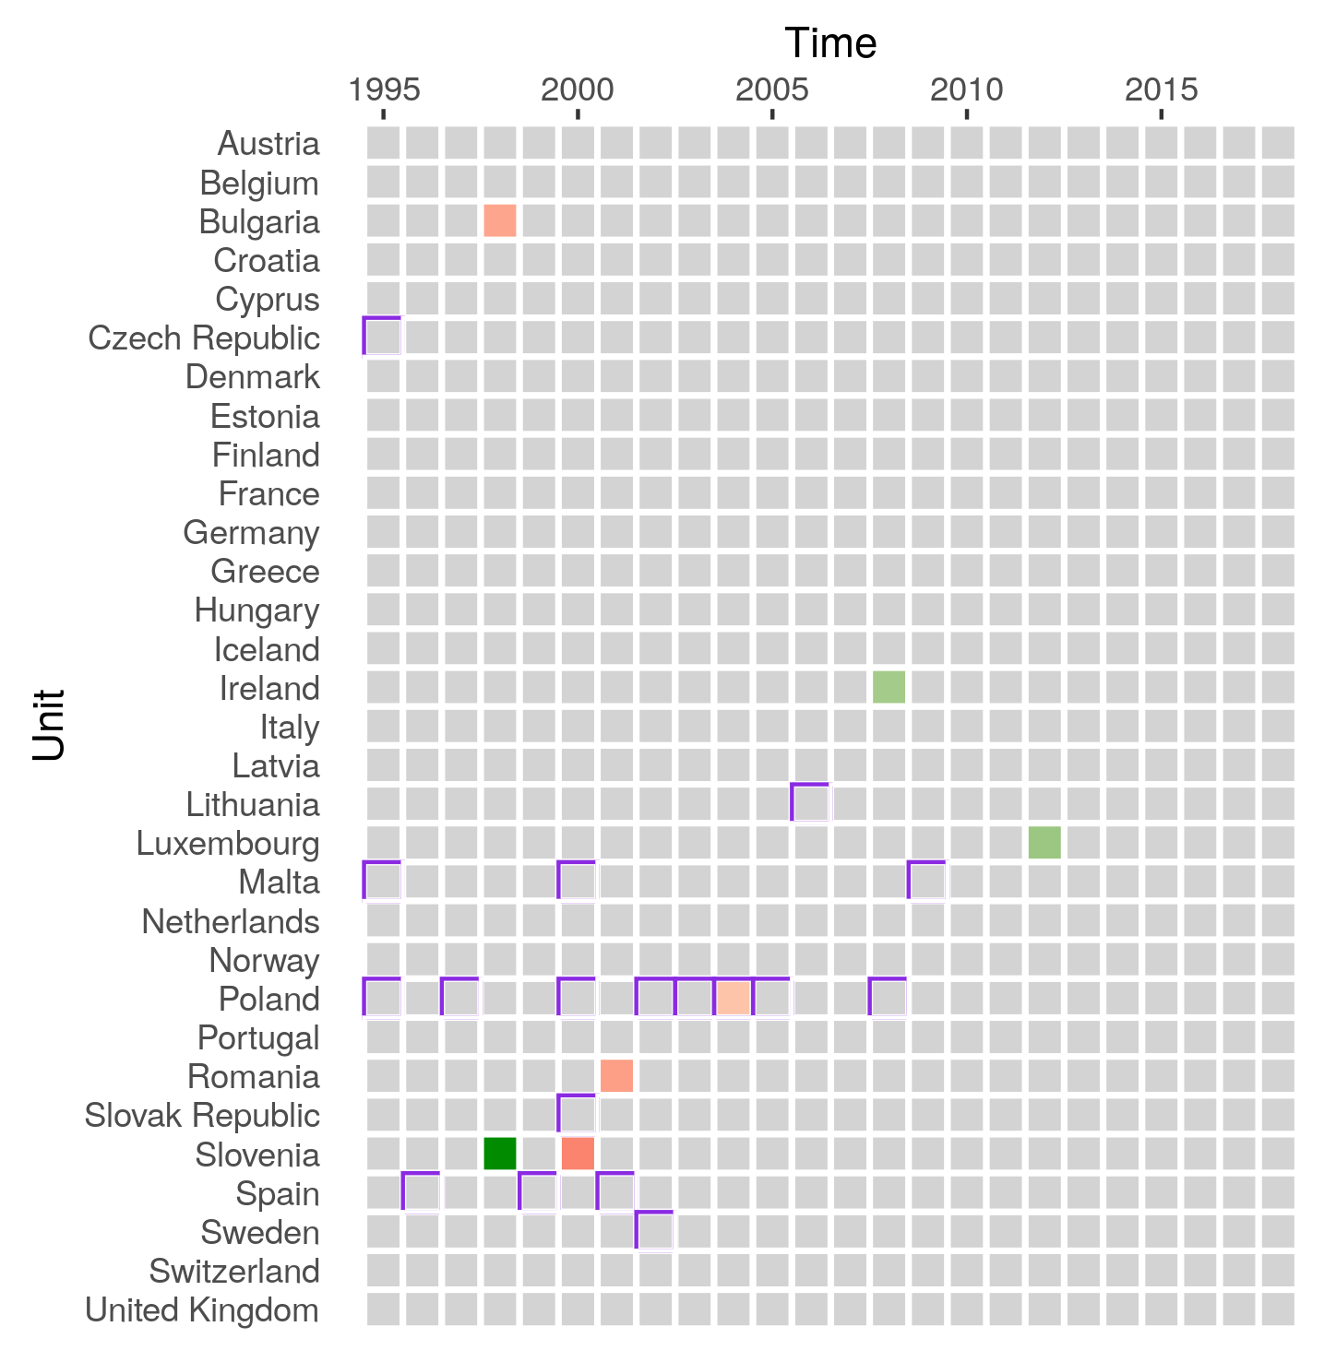
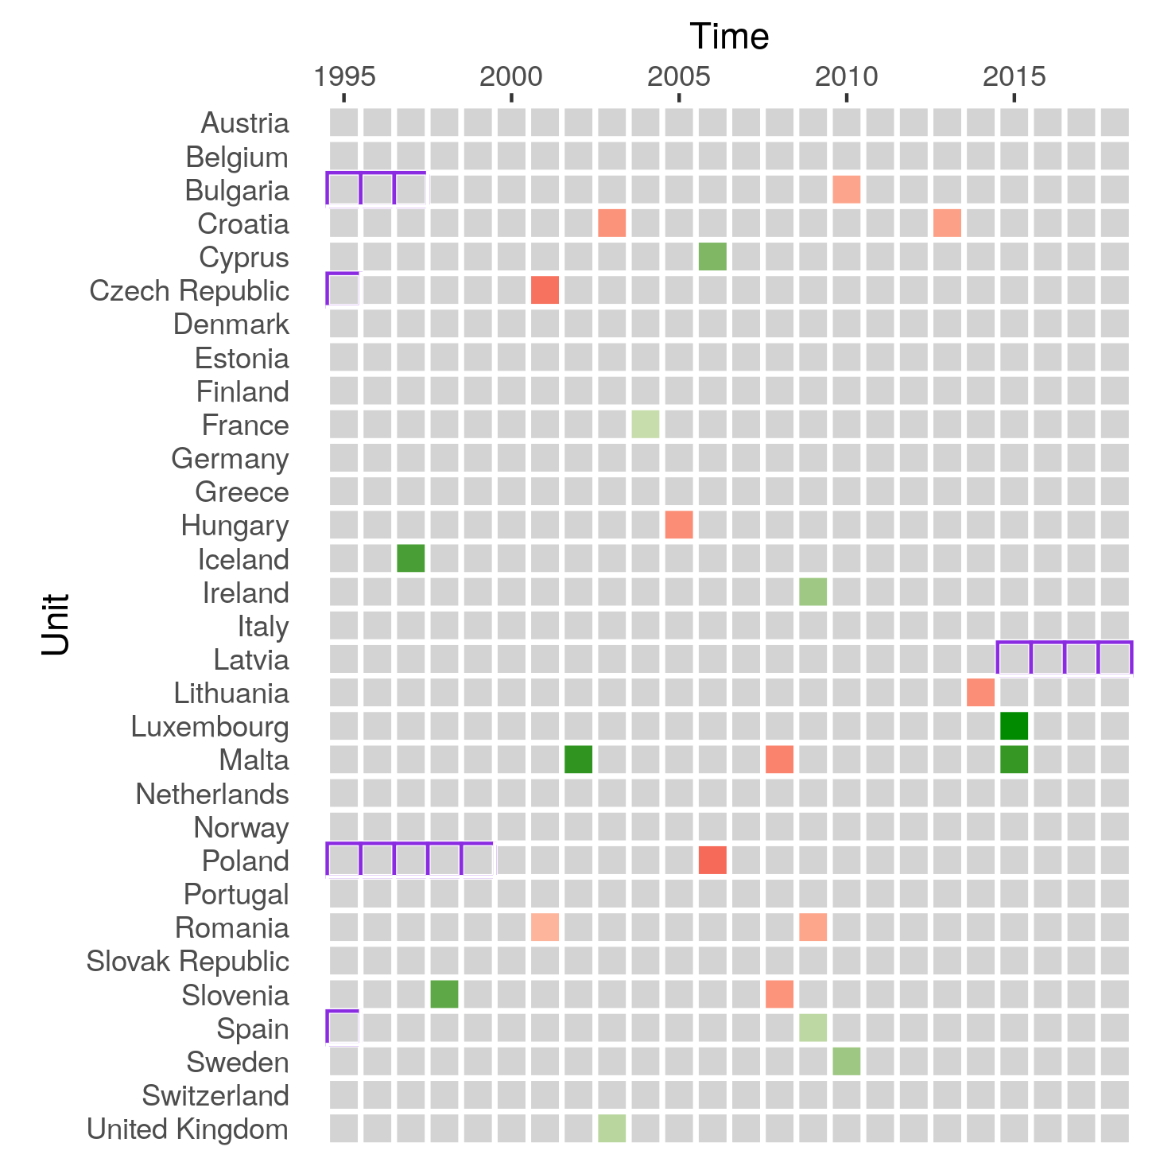
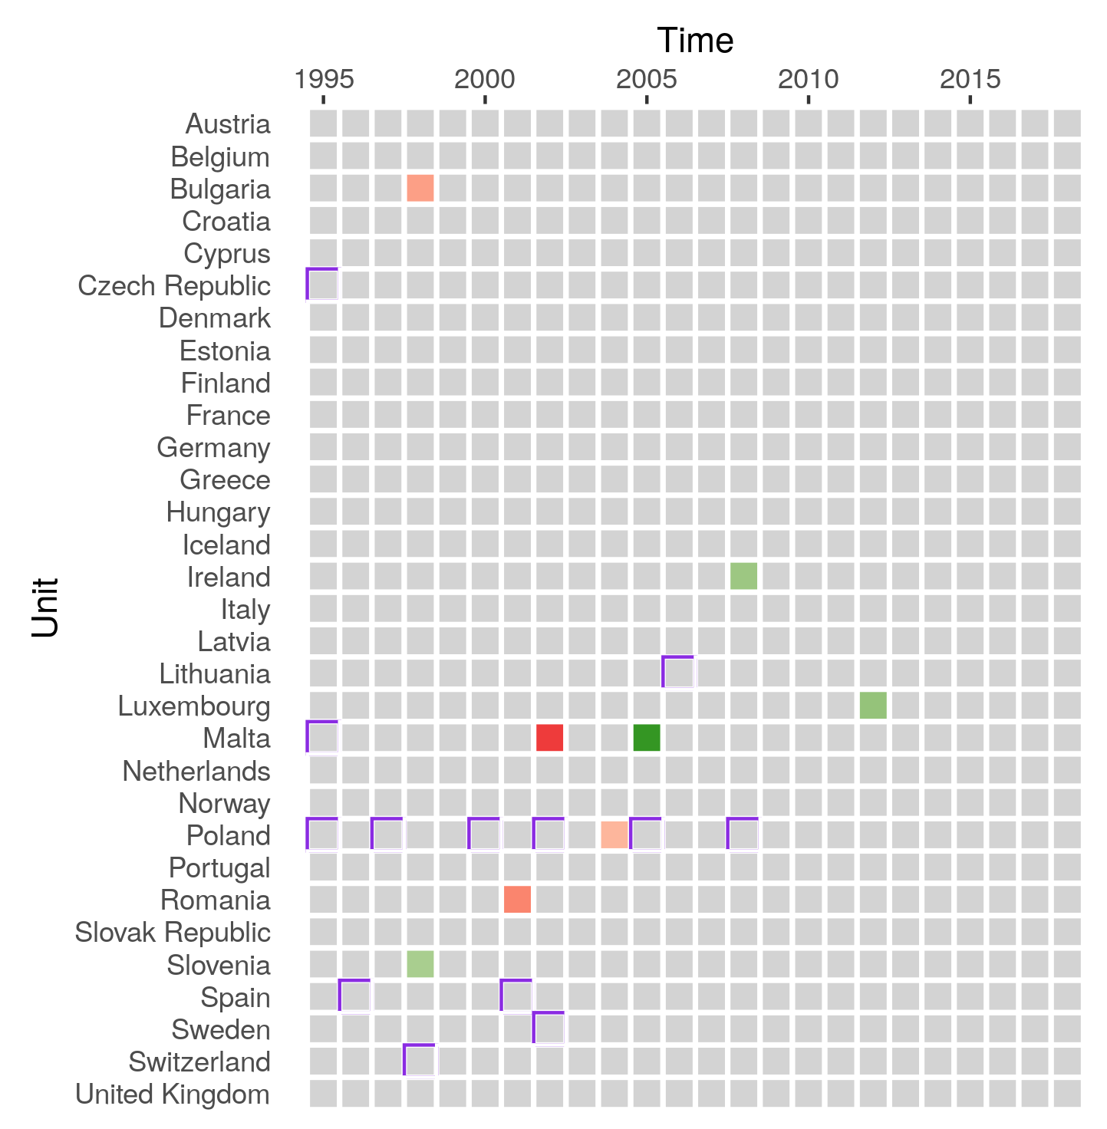
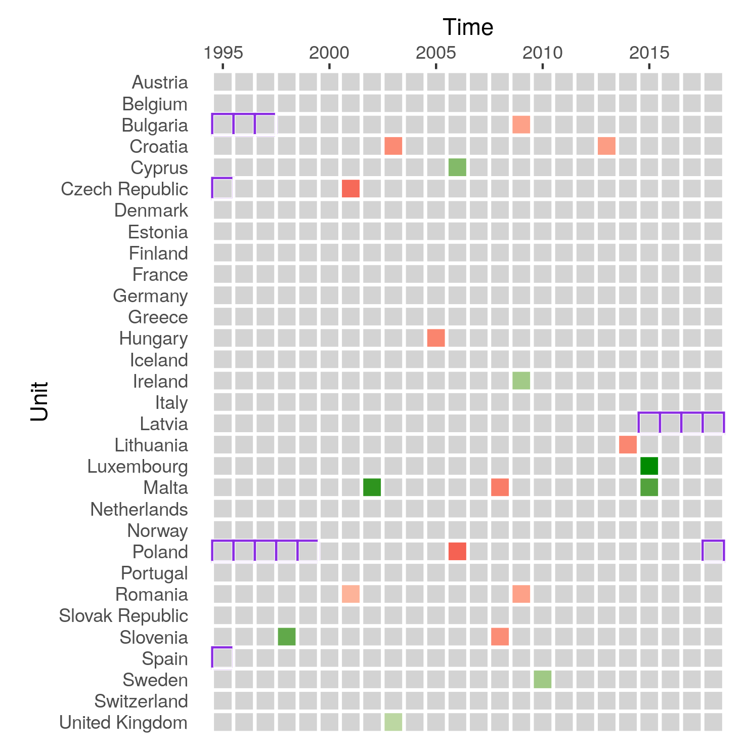
EU31
DV: log(CO2)
with autoregressive lag
without autoregressive lag
1%
False Positive Rate: 0.5%
DV: log(CO2 p.c.)
with autoregressive lag
without autoregressive lag
1%
False Positive Rate: 0.5%

Slide 3
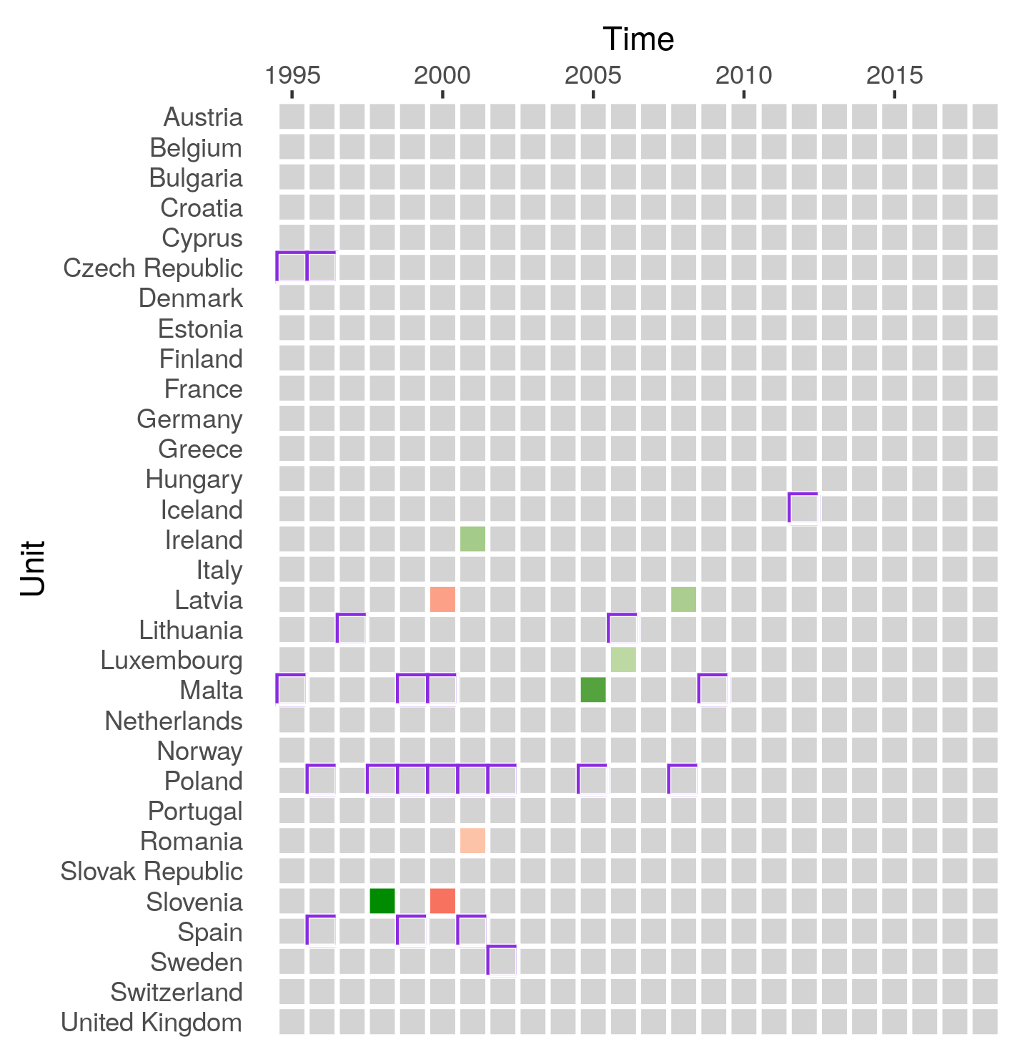


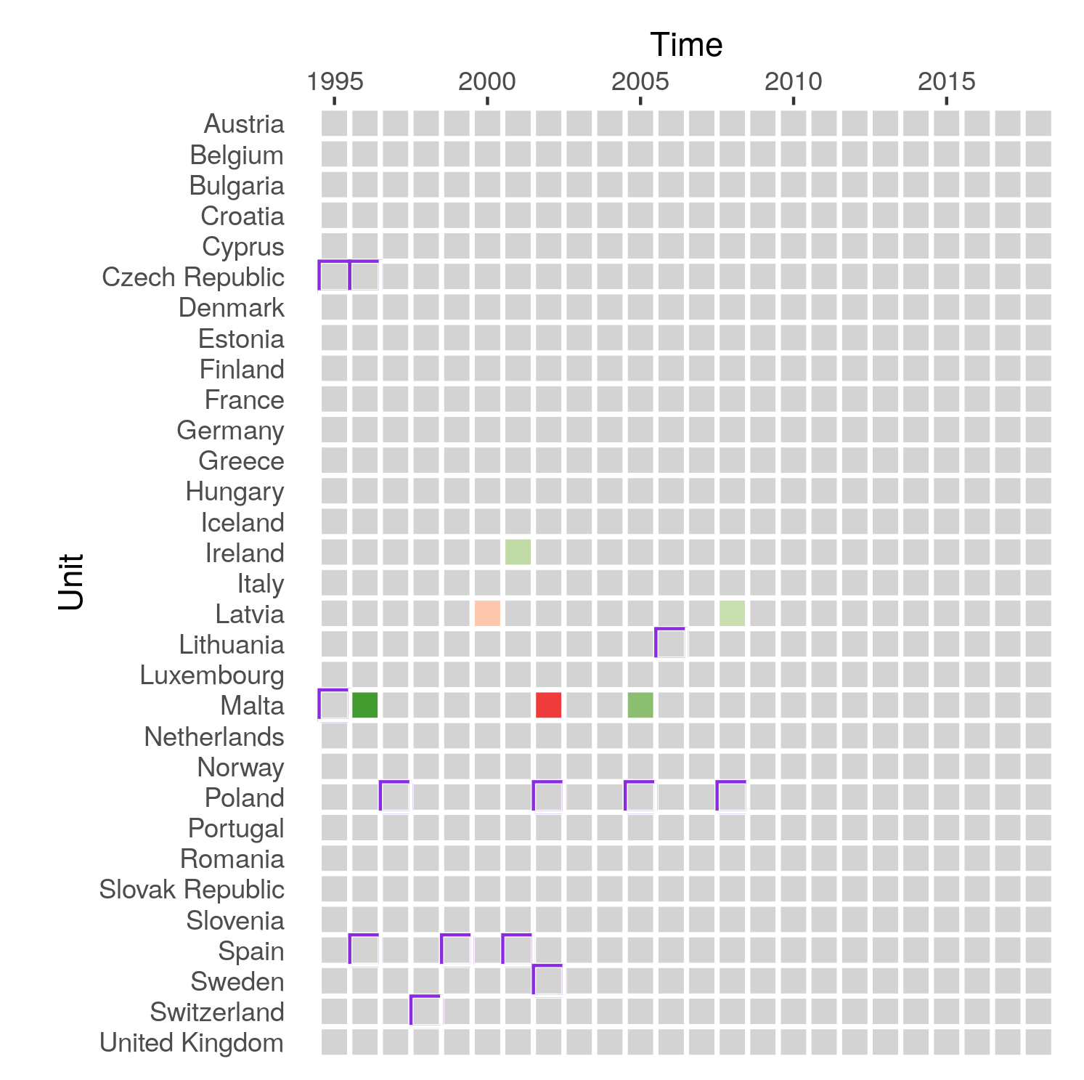
EU31
DV: growth rate(CO2 p.c.)
without autoregressive lag
with autoregressive lag
1%
False Positive Rate: 0.5%

Slide 4
Possible Treatments
Only negative breaks
only without AR lag
Only EU15 countries
Country | Year | Sample | DV | Effect Size | Possible Treatment
Finland** | 2000 | EU15 | level | -0.12 | ?2001: Change of basis for annual car ownership tax from total mass to CO2 emissions (ACEA 2016)? ?1997: Significant increase in carbon tax?
Sweden** | 2001 | EU15 | both | -0.10 (level) -0.07 (pc) | 2001-2005: Carbon tax increase from US$44 to US$109 per ton of CO2 (roughly equivalent to 10ct/litre of petrol burned -> 25ct/litre) ⬄ 2001-2006: „Green Tax Shift“ (2001-2006): overall raise of environmental taxes, income tax cuts, tax relief for biofuels
Germany** | 2002/2003 | EU15 | both | -0.13 | ?1999-2003: Annual increase of mineral oil tax on fuel by 3.07ct/litre, respectively? ?2004: Reduction of distance-based tax allowance for commuters from 36ct/km to 30ct/km (National Communication, p.87)? ?2004: fuel and CO2 consumption labelling obligations for cars enter into force (ibid, p.88)?
UK** | 2003 | EU31 | both | -0.15 (level) -0.11(pc) | 2002: Company Car Tax Reform: now taxed on a percentage of their list price according to CO2 emission bands; “following a review of the existing regime [which] encouraged those using company cars to drive extra, unnecessary miles on business”
France* | 2004 | EU31 | both | -0.11 (level) -0.09 (pc) | 2002: Road safety measures (speed limit decrease, penalty increase, extension of controls) (National Communication, p.74)
Germany** | 2005 | EU31 | level | -0.18 | 2005: Einführung der LKW-Maut auf Autobahnen und einigen Bundesstraßen
Sweden** | 2006 | EU31 | level | -0.15 | 2001-2005: Carbon tax increase from US$44 to US$109 per ton of CO2 between (roughly equivalent to 10ct/litre of petrol burned -> 25ct/litre) ⬄ 2001-2006: „Green Tax Shift“ (2001-2006): overall raise of environmental taxes, income tax cuts, tax relief for biofuels ?2007-2009: Green Car Subsidy of 1000€ (National Communication, p.48)?
Luxembourg** | 2007 | EU15 | both | -0.08 (level) -0.138 (pc) | 2007: Vehicle Tax Reform based on CO2 emissions (National Communication, p. 163) ?2007: subsidy of 750€ for purchase of energy efficient cars (ibid, p.164)? ?2007-2008: Raise in fuel tax by 2ct/litre (ibid, p.167)?
Ireland** | 2009/2010 | both | pc | -0.15 | ?2008: Change of basis for Vehicle Registration Tax and Motor Tax (annual) from engine size to CO2 emissions? 2009: Introduction of Carbon Tax of 15€/tonne, increase of 20€ in 2011 (National Communication, p. 99) ?2009: introduction of tax incentive of up to 1000€ for the purchase of bicycles for commuting (ibid, p.108)?
Sweden** | 2010 | EU31 | pc | -0.16 | 2009: Exemption of „green cars“ from annual road tax for five years, both private and business (ACEA 2016) ?2011: „Inclusion of light commercial vehicles and light vehicles into system of CO2-differentiated vehicle tax“?
Netherlands** | 2014 | EU31 | level | -0.14 | ???
Ireland | 2015 | both | level | -0.19 (EU15) -0.24 (EU31) | ?2015: Increse in Mineral Oil Tax
Luxembourg | 2015 | EU31 | pc | -0.4 | ???

